Slide 1
FINAL PROJECT SOLUTIONS

Slide 2
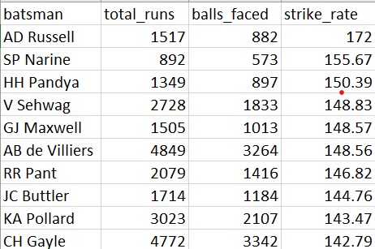

Your first priority is to get 2-3 players with high S.R who have faced at least 500 balls. And to do that you have to make a list of 10 players you want to bid in the auction so that when you try to grab them in auction you should not pay the amount greater than you have in the purse for a particular player.
SELECT batsman, SUM(batsman_runs) AS total_runs, COUNT(*) AS balls_faced,
ROUND((SUM(batsman_runs) * 100.0 / COUNT(*)), 2) AS strike_rate
FROM Ball GROUP BY batsman
HAVING COUNT(*) >= 500 ORDER BY strike_rate DESC LIMIT 10;
Strike rate=$\frac{\text{No}\text{. }\text{of} \text{runs} \text{scored}}{No. of Balls faced by batsman}$

Slide 3
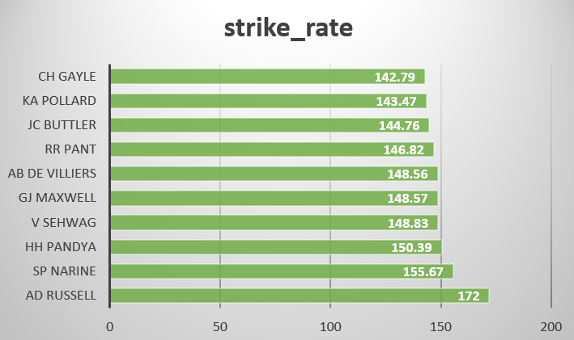

Slide 4
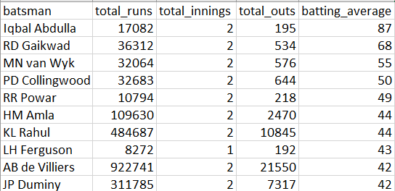

Now you need to get 2-3 players with good Average who have played more the 2 ipl seasons.And to do that you have to make a list of 10 players you want to bid in the auction so that when you try to grab them in auction you should not pay the amount greater than you have in the purse for a particular player.
SELECT b.batsman, SUM(b.batsman_runs) AS total_runs, COUNT(DISTINCT b.inning) AS total_innings,
SUM(CASE WHEN b.is_wicket = 1 THEN 1 ELSE 0 END) AS total_outs,
SUM(b.batsman_runs) / NULLIF(SUM(CASE WHEN b.is_wicket = 1 THEN 1 ELSE 0 END), 0) AS batting_average
FROM Ball b
inner JOIN
Matches m ON b.batting_team = m.team1 OR b.batting_team = m.team2
GROUP BY b.batsman HAVING SUM(CASE WHEN b.is_wicket = 1 THEN 1 ELSE 0 END) > 0
AND COUNT(DISTINCT m.id) >= 2
ORDER BY
batting_average DESC
LIMIT 10;
Batting Avg=$\frac{Total no. of runs scored}{No. of times they have been out}$

Slide 5
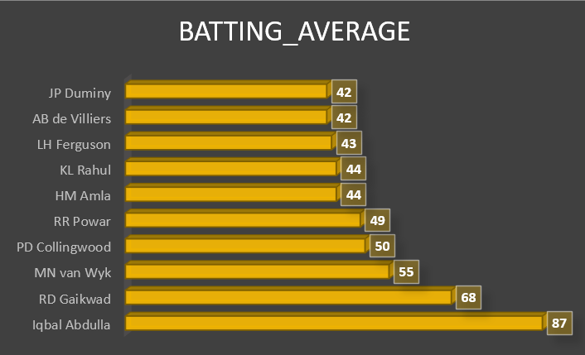

Slide 6
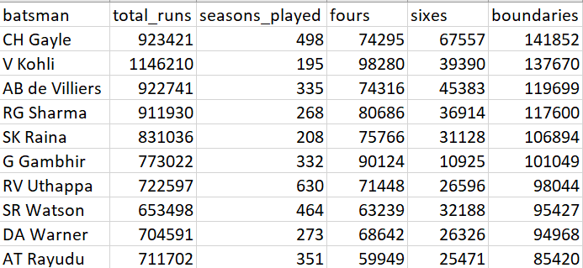
Now you need to get 2-3 Hard-hitting players who have scored most runs in boundaries and have played more the 2 ipl season. To do that you have to make a list of 10 players you want to bid in the auction so that when you try to grab them in auction you should not pay the amount greater than you have in the purse for a particular player.
SELECT
b.batsman,
SUM(b.batsman_runs) AS total_runs,
COUNT(DISTINCT m.id) AS seasons_played,
SUM(CASE WHEN b.batsman_runs = 4 THEN 1 ELSE 0 END) AS fours,
SUM(CASE WHEN b.batsman_runs = 6 THEN 1 ELSE 0 END) AS sixes,
SUM(CASE WHEN b.batsman_runs = 4 OR b.batsman_runs = 6 THEN 1 ELSE 0 END) AS boundaries
FROM Ball b JOIN Matches m ON b.batting_team = m.team1 OR b.batting_team = m.team2
GROUP BY
b.batsman
ORDER BY
boundaries desc
LIMIT 10;

Slide 7
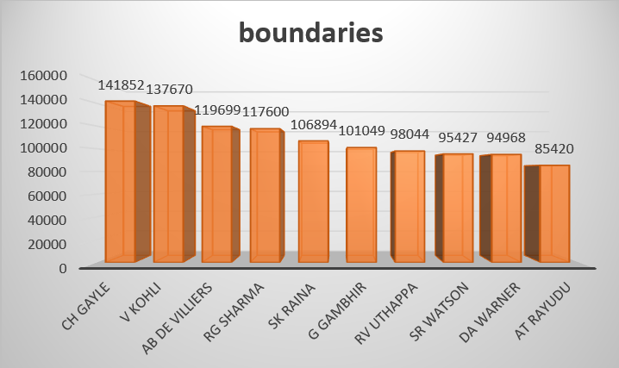

Slide 8
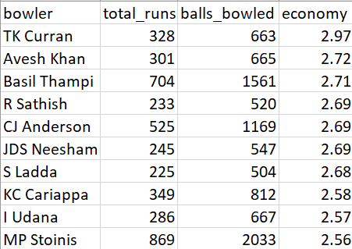

Your first priority is to get 2-3 bowlers with good economy who have bowled at least 500 balls in IPL so far.To do that you have to make a list of 10 players you want to bid in the auction so that when you try to grab them in auction you should not pay the amount greater than you have in the purse for a particular player.
SELECT bowler,
SUM(total_runs) AS total_runs,
SUM(ball) AS balls_bowled,
ROUND(SUM(total_runs) * 6.0 / SUM(ball), 2) AS economy
FROM Ball
GROUP BY bowler
HAVING balls_bowled >= 500
ORDER BY economy ASC
LIMIT 10;
$$Economy=\frac{total runs conceded }{total overs bowled}$$

Slide 9
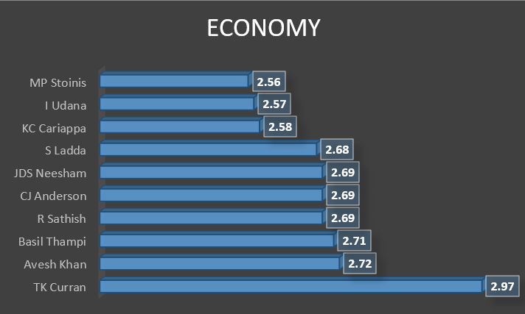

Slide 10
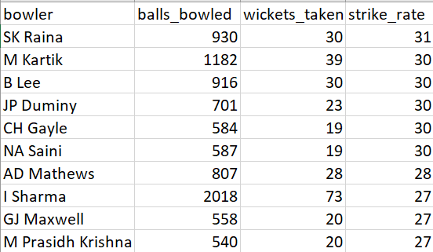

Now you need to get 2-3 bowlers with the best strike rate and who have bowled at least 500 balls in IPL so far.To do that you have to make a list of 10 players you want to bid in the auction so that when you try to grab them in auction you should not pay the amount greater than you have in the purse for a particular player.
SELECT bowler,
COUNT(*) AS balls_bowled,
SUM(CASE WHEN is_wicket = 1 THEN 1 ELSE 0 END) AS wickets_taken,
COUNT(*) / SUM(CASE WHEN is_wicket = 1 THEN 1 ELSE 0 END) AS strike_rate
FROM Ball
GROUP BY bowler
HAVING count(*) >= 500
ORDER BY strike_rate desc
LIMIT 10;
$$Bowlers Strike Rate=\frac{Total balls bowled by player}{No. of wickets claimed}$$

Slide 11
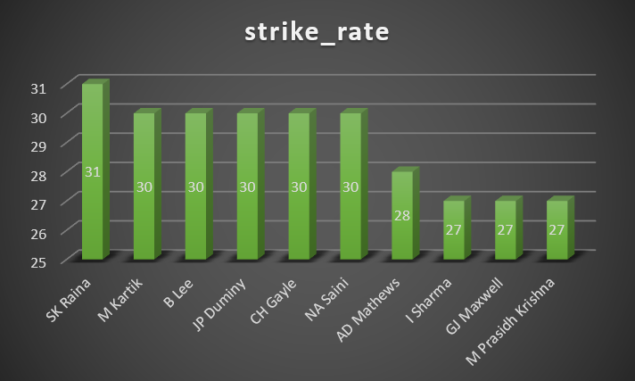

Slide 12
Now you need to get 2-3 All_rounders with the best batting as well as bowling strike rate and who have faced at least 500 balls in IPL so far and have bowled minimum 300 balls.To do that you have to make a list of 10 players you want to bid in the auction so that when you try to grab them in auction you should not pay the amount greater than you have in the purse for a particular player.
WITH Batting AS (SELECT batsman, SUM(batsman_runs) AS total_runs, COUNT(*) AS balls_faced, ROUND((SUM(batsman_runs) * 100.0 / COUNT(*)), 2) AS strike_rate
FROM Ball GROUP BY batsman HAVING COUNT(*) >= 500),
Bowling AS (SELECT bowler, COUNT(*) AS balls_bowled, SUM(CASE WHEN is_wicket = 1 THEN 1 ELSE 0 END) AS wickets_taken FROM Ball GROUP BY bowler HAVING COUNT(*) >= 300)
SELECT Batting.batsman, Batting.total_runs, Batting.balls_faced, Batting.strike_rate AS batting_strike_rate, Bowling.balls_bowled, Bowling.wickets_taken,
ROUND((Bowling.balls_bowled / NULLIF(Bowling.wickets_taken, 0)), 2) AS bowling_strike_rate,
(Batting.strike_rate+(ROUND((Bowling.balls_bowled / NULLIF(Bowling.wickets_taken, 0)), 2))) as all_rounders
FROM Batting JOIN Bowling ON Batting.batsman = Bowling.bowler
ORDER BY (Batting.strike_rate+(ROUND((Bowling.balls_bowled / NULLIF(Bowling.wickets_taken, 0)), 2))) desc
LIMIT 10;

Slide 13
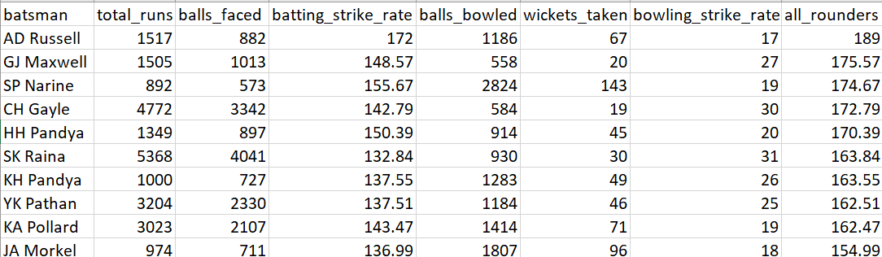

Slide 14
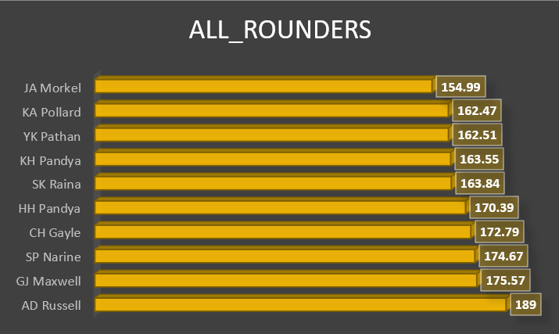

Slide 15
Final Assessment
Get the count of cities that have hosted an IPL match
SELECT COUNT(DISTINCT city) AS city_count
FROM Matches;

Slide 16
2. Create table deliveries_v02 with all the columns of the table ‘deliveries’ and an additional column ball_result containing values boundary, dot or other depending on the total_run (boundary for >= 4, dot for 0 and other for any other number) (Hint 1 : CASE WHEN statement is used to get condition based results) (Hint 2: To convert the output data of the select statement into a table, you can use a subquery. Create table table_name as [entire select statement].
CREATE TABLE deliveries_v02 AS
SELECT *,
CASE
WHEN total_runs >= 4 THEN 'boundary'
WHEN total_runs = 0 THEN 'dot'
ELSE 'other'
END AS ball_result
FROM Ball;

Slide 17
Write a query to fetch the total number of boundaries and dot balls from the deliveries_v02 table.
SELECT
SUM(CASE WHEN ball_result = 'boundary' THEN 1 ELSE 0 END) AS total_boundaries,
SUM(CASE WHEN ball_result = 'dot' THEN 1 ELSE 0 END) AS total_dot_balls
FROM deliveries_v02;

Slide 18
4. Write a query to fetch the total number of boundaries scored by each team from the deliveries_v02 table and order it in descending order of the number of boundaries scored.
SELECT batting_team,
SUM(CASE WHEN ball_result = 'boundary' THEN 1 ELSE 0 END) AS total_boundaries
FROM deliveries_v02
GROUP BY batting_team
ORDER BY total_boundaries DESC;

Slide 19
5. Write a query to fetch the total number of dot balls bowled by each team and order it in descending order of the total number of dot balls bowled.
SELECT bowling_team,
SUM(CASE WHEN ball_result = 'dot' THEN 1 ELSE 0 END) AS total_dot_balls
FROM deliveries_v02
GROUP BY bowling_team
ORDER BY total_dot_balls DESC;

Slide 20
6. Write a query to fetch the total number of dismissals by dismissal kinds where dismissal kind is not NA
SELECT dismissal_kind, COUNT(*) AS total_dismissals
FROM Ball
WHERE dismissal_kind != 'NA'
GROUP BY dismissal_kind;

Slide 21
7. Write a query to get the top 5 bowlers who conceded maximum extra runs from the deliveries table
SELECT bowler, SUM(extra_runs) AS total_extra_runs
FROM Ball
GROUP BY bowler
ORDER BY total_extra_runs DESC
LIMIT 5;

Slide 22
8. Write a query to create a table named deliveries_v03 with all the columns of deliveries_v02 table and two additional column (named venue and match_date) of venue and date from table matches
CREATE TABLE deliveries_v03 AS
SELECT d.*, m.venue, m.date AS match_date
FROM deliveries_v02 AS d
JOIN Matches AS m ON d.id = m.id;

Slide 23
9. Write a query to fetch the total runs scored for each venue and order it in the descending order of total runs scored.
SELECT venue, SUM(total_runs) AS total_runs_scored
FROM deliveries_v03
GROUP BY venue
ORDER BY total_runs_scored DESC;

Slide 24
10. Write a query to fetch the year-wise total runs scored at Eden Gardens and order it in the descending order of total runs scored.
SELECT EXTRACT(YEAR FROM match_date) AS year,
SUM(total_runs) AS total_runs_scored
FROM deliveries_v03
WHERE venue = 'Eden Gardens'
GROUP BY year
ORDER BY total_runs_scored DESC;

